Slide 1

Deep learning for fruits image classification
Nicola Gheza
10-04-2019

Slide 2
Introduction
This thesis will examine the effectiveness of SoA deep learning techniques for the recognition and detection of fruits in benchmark datasets.

Slide 3
Research questions
What are the characteristics of existing fruit databases, and the reason for them?
What current SoA deep learning classification methods are best suited for fruit classification?
How can transfer learning help extend the existing DL recognition/classification methodologies to less constrained data?

Slide 4

State-of-the-Art
“To make robotic crop harvesting a reality three key challenges have to be solved: Automatic Crop detection, Automatic Crop Localisation, and Automatic Crop Manipulation”^{[6]}
GRADING & SORTING SOLUTIONS FOR FRUITS AND VEGETABLES
Internal quality
External quality
Color and Size separation
Weight

Slide 5
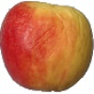
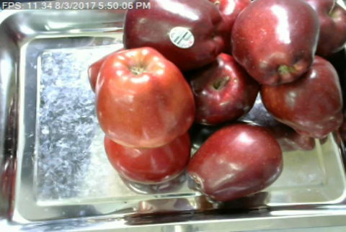
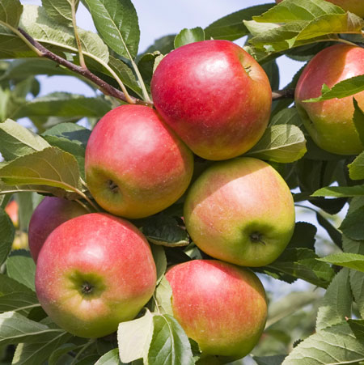
Dataset
Classification:
Fruits-360^{[1]}
65429 images, 100x100 pixels, 95 fruits.
Fruit Recognition dataset^{[2]}
44406 images, 320x258 pixels, 15 fruits
Detection:
DeepFruits Dataset^{[3]}
500 images, 500x375 pixels, 7 fruits
Bounding boxes available

Slide 6
Methodology
Deep CNN
(Based on Fruit recognition from images using deep learning^{[1]})
Transfer Learning
(Fine Tuning Inception-v3)

Slide 7
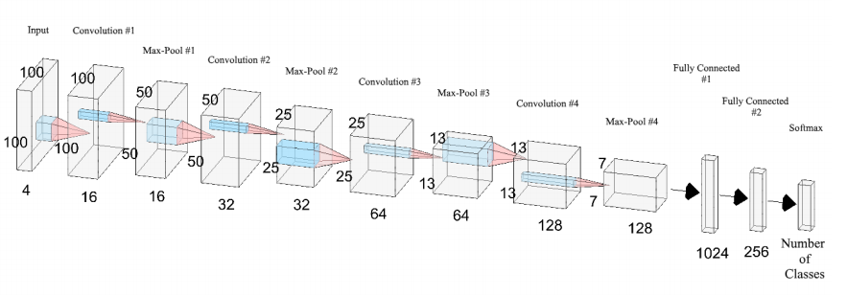
Deep CNN - Architectures
Graphical representation of the convolutional neural network used in experiments^{[1]}.

Slide 8
Deep CNN – Experiments
9 architectures x 50 epochs, Grayscale Images;
10 architectures x 50 epochs, HSV Images;

Slide 9
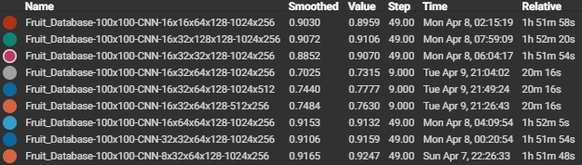
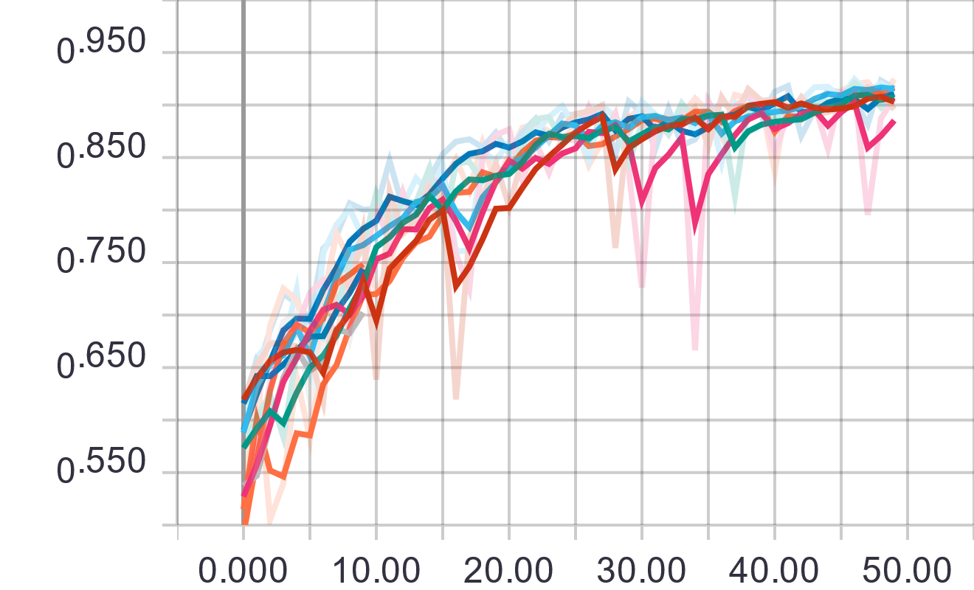
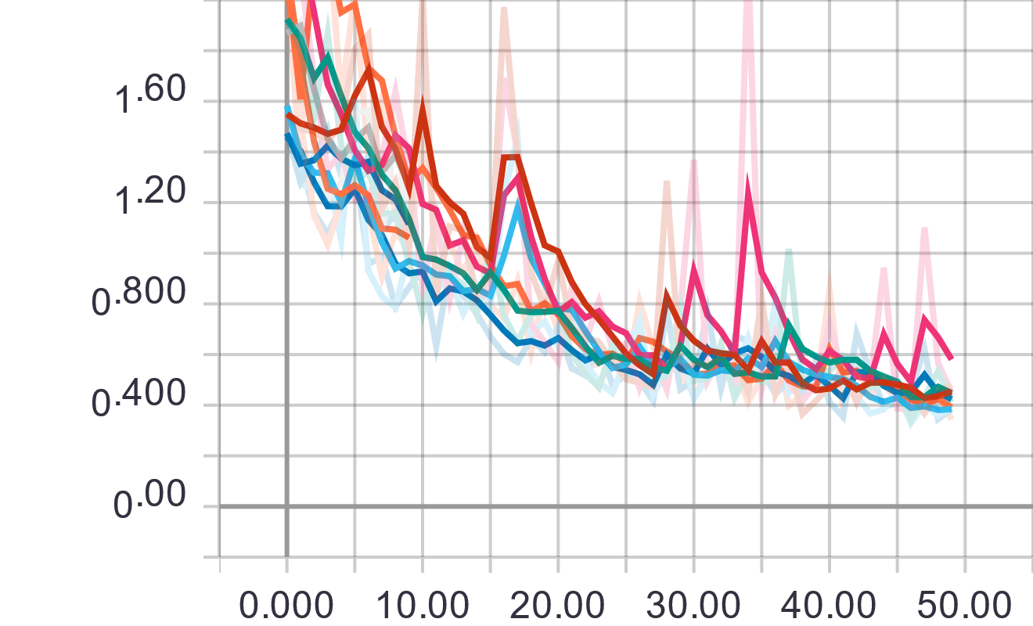
Deep CNN – Fruit Recognition dataset Results 1

Slide 10
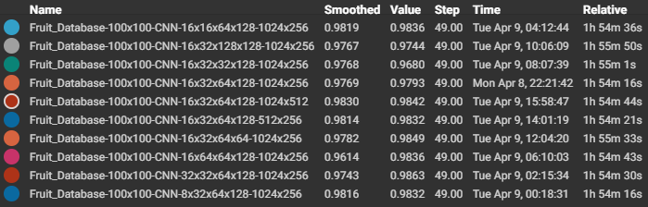
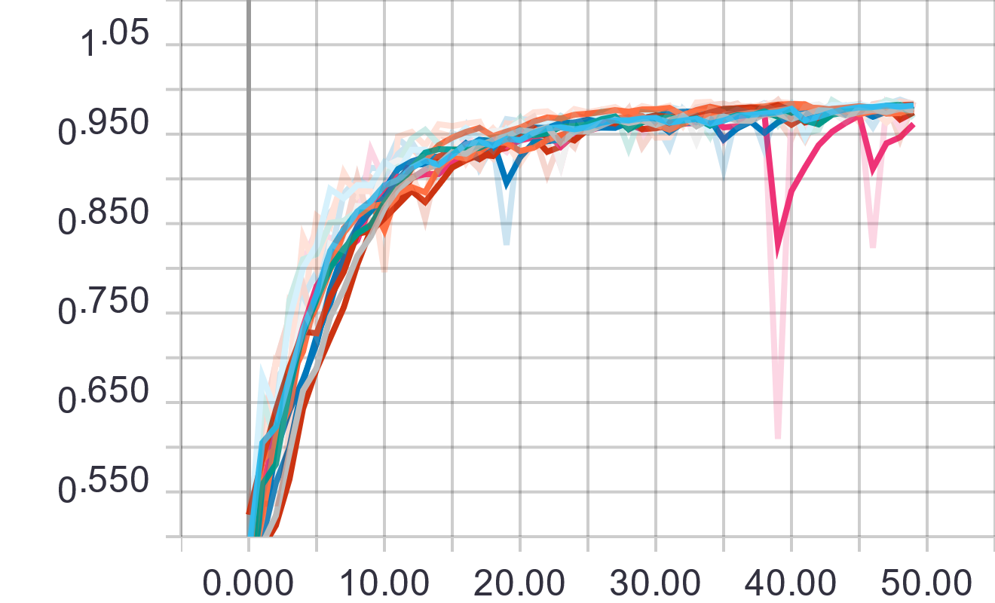
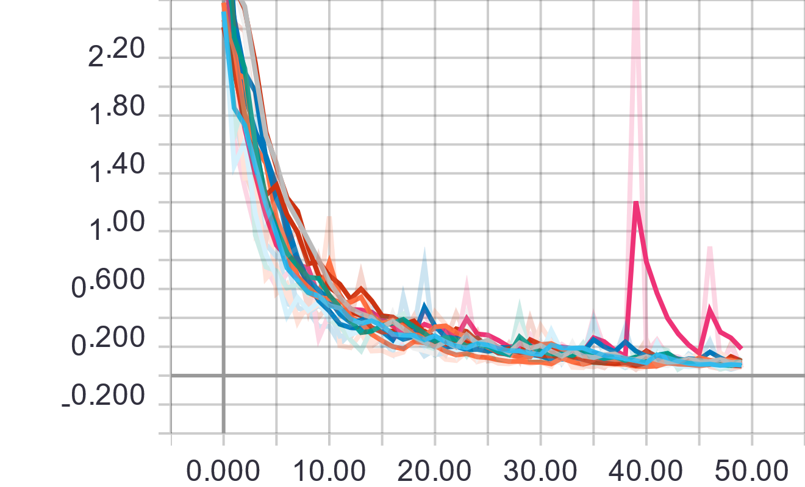
Deep CNN – Fruit Recognition dataset Results 2

Slide 11
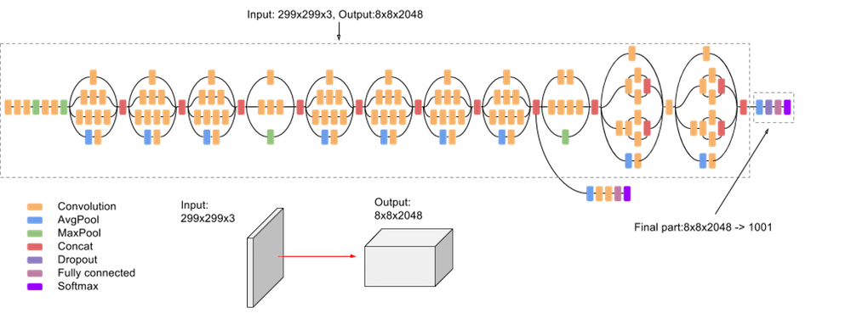
Fine Tuning Inception_v3
Inception-v3 Architecture (Batch Norm and ReLU are used after Conv) ^{[5]}

Slide 12
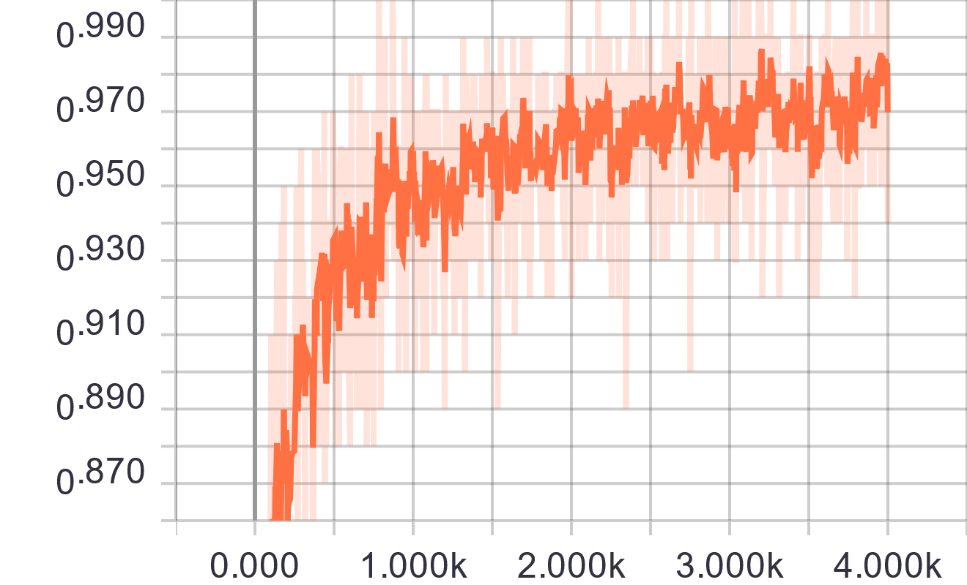
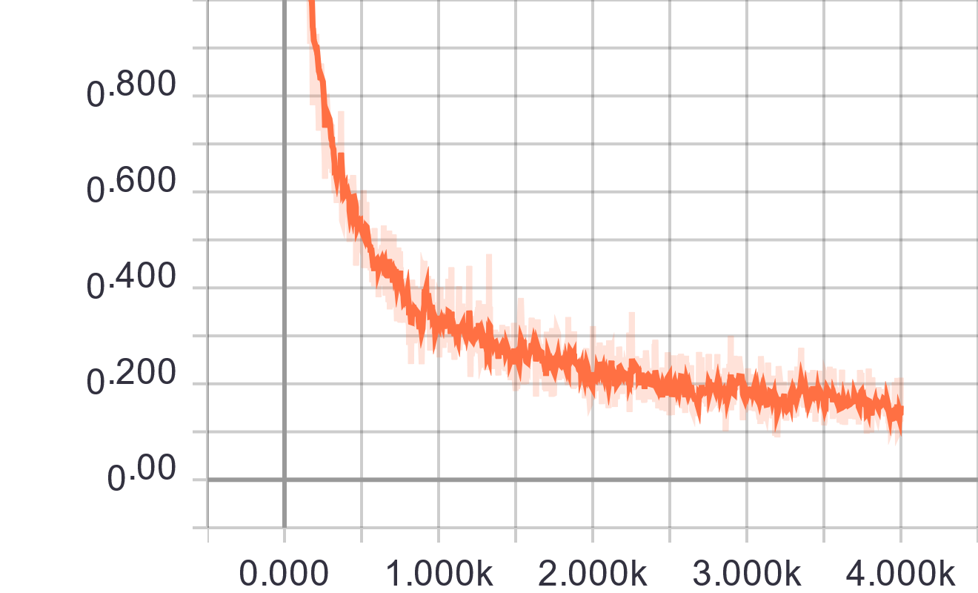
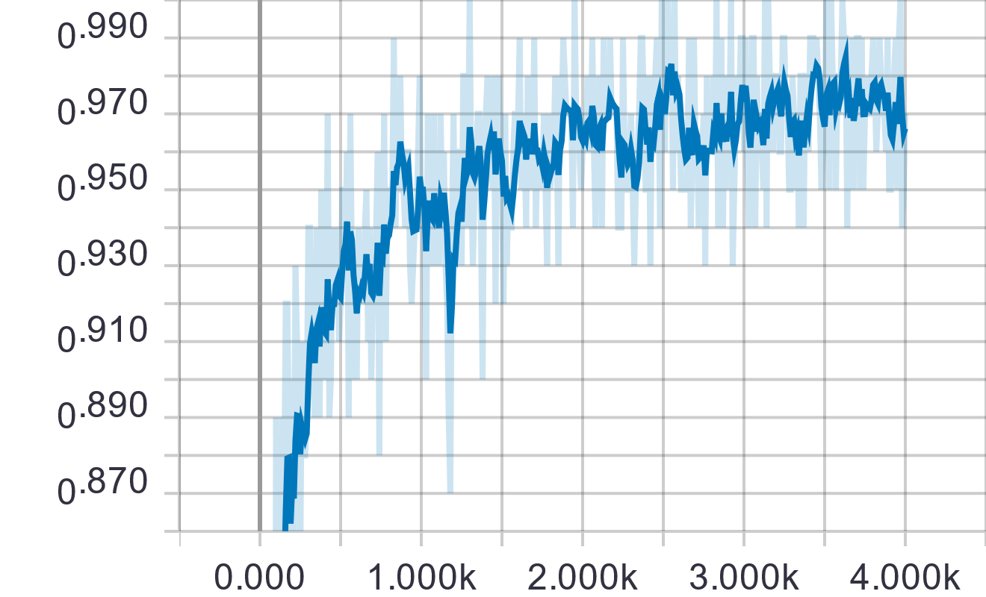
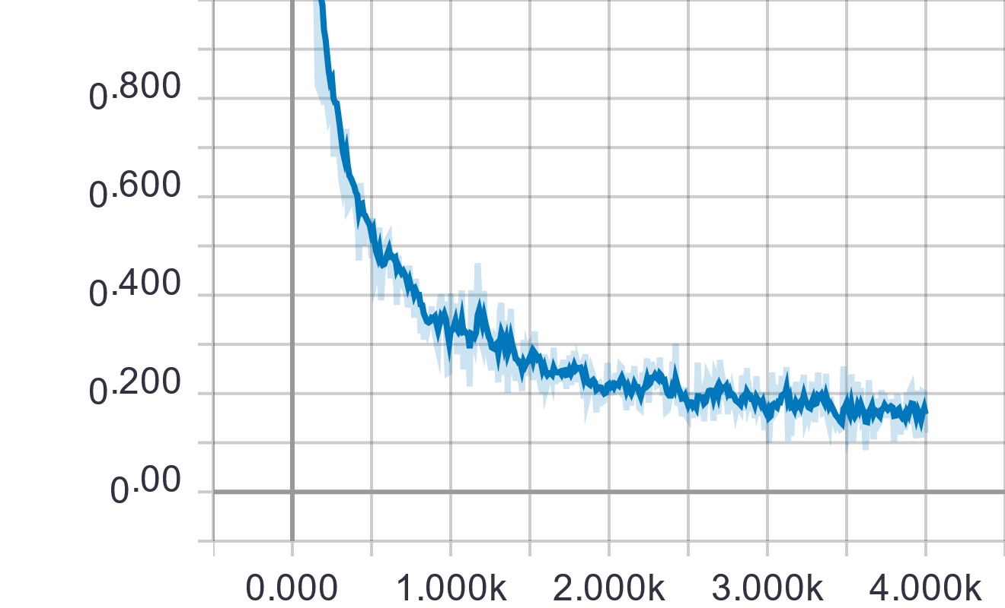
Fine Tuning Inception_v3 – Results 1
Fruit Recognition dataset: 96.5% Val. Accuracy
Accuracy Cross Entropy
Training
Validation

Slide 13
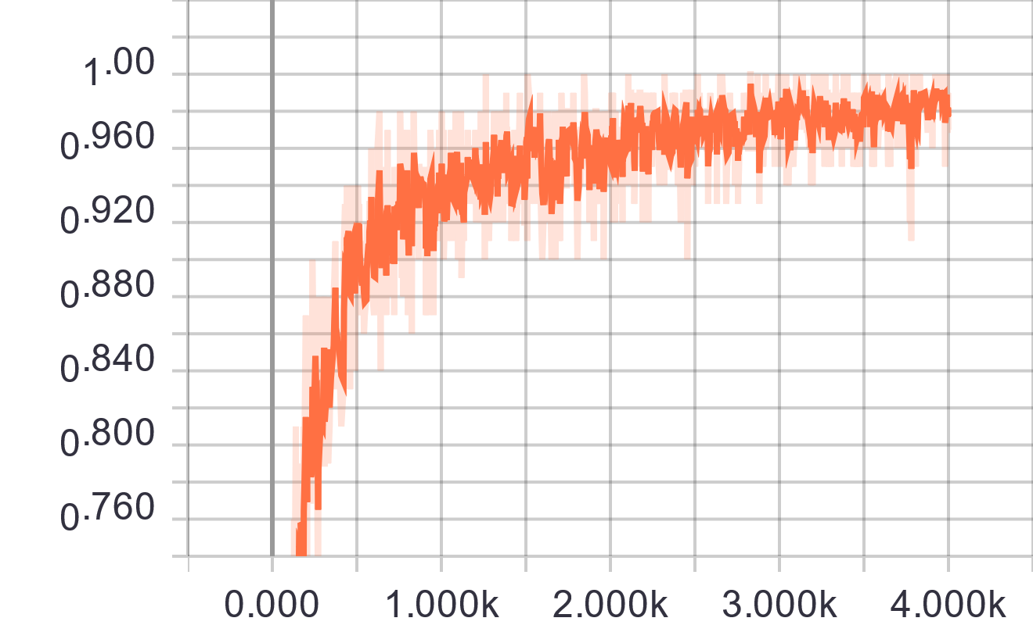
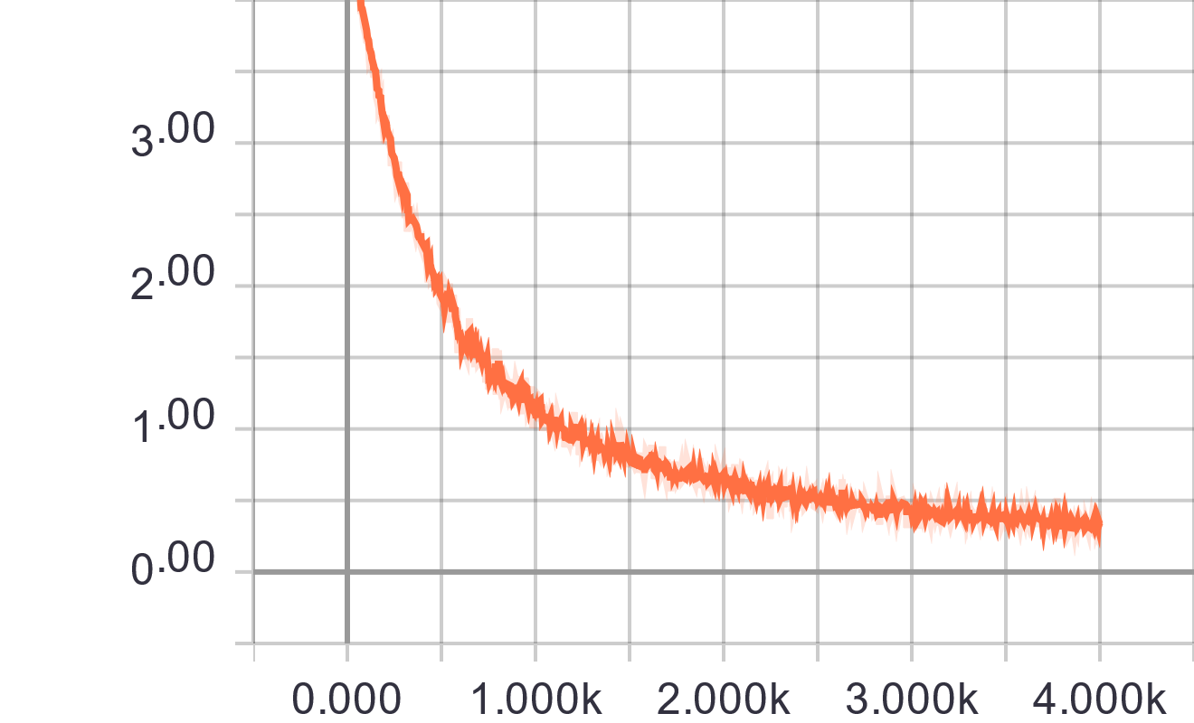
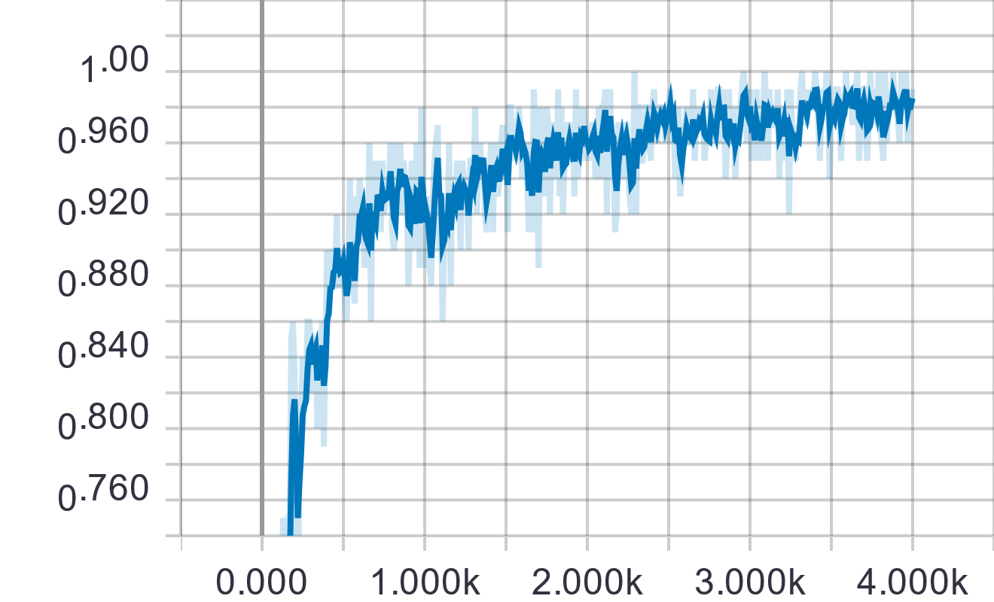
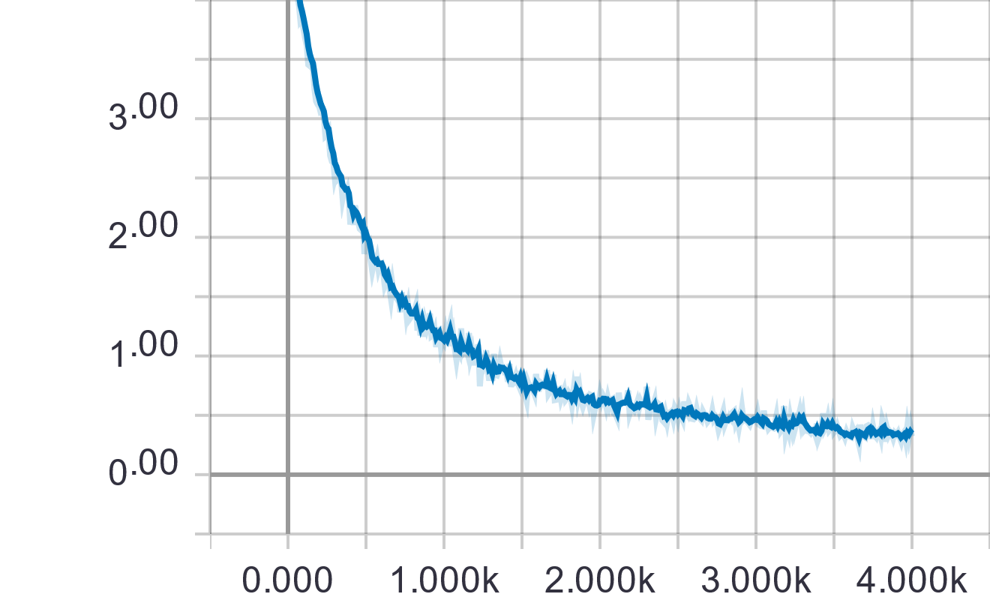
Fine Tuning Inception_v3 – Results 2
Fruit-360 dataset: 98.1% Val. Accuracy
Accuracy Cross Entropy
Training
Validation

Slide 14
Further Work
Improve classification models
Different scenarios (i.e. HSV + Grayscale, RGB)
More epochs (i.e. 10k to 70k)
Different base models for Fine Tuning (i.e. Inception-v4 , NASNet)
Fruit detection using Faster R-CNN^{[3]}
YOLO
Weakly Supervised Object Localization^{[4]}

Slide 15
References
[1] Horea Muresan, Mihai Oltean, Fruit recognition from images using deep learning, Acta Univ. Sapientiae, Informatica Vol. 10, Issue 1, pp. 26-42, 2018.
[2] Israr Hussain,, Qianhua He, Zhuliang Chen, & Wei Xie. (2018). Fruit Recognition dataset (Version V 1.0) [Data set]. Zenodo. http://doi.org/10.5281/zenodo.1310165
[3] Sa, I.; Ge, Z.; Dayoub, F.; Upcroft, B.; Perez, T.; McCool, C. DeepFruits: A Fruit Detection System Using Deep Neural Networks. Sensors 2016, 16, 1222.
[4] Oquab, Maxime, et al. "Is object localization for free?-weakly-supervised learning with convolutional neural networks." Proceedings of the IEEE Conference on Computer Vision and Pattern Recognition. 2015.
[5] https://cloud.google.com/tpu/docs/inception-v3-advanced
[6] McCool C., Sa I., Dayoub F., Lehnert C., Perez T., Upcroft B. Visual Detection of Occluded Crop: For automated harvesting; Proceedings of the International Conference on Robotics and Automation; Stockholm, Sweden. 16–21 May 2016.

